Slide 1
Final Report
Kallen Haun

Slide 2




Introduction
The Client
Image of the headquarters
The choice is between Toronto on the left and New York on the right.

Slide 3
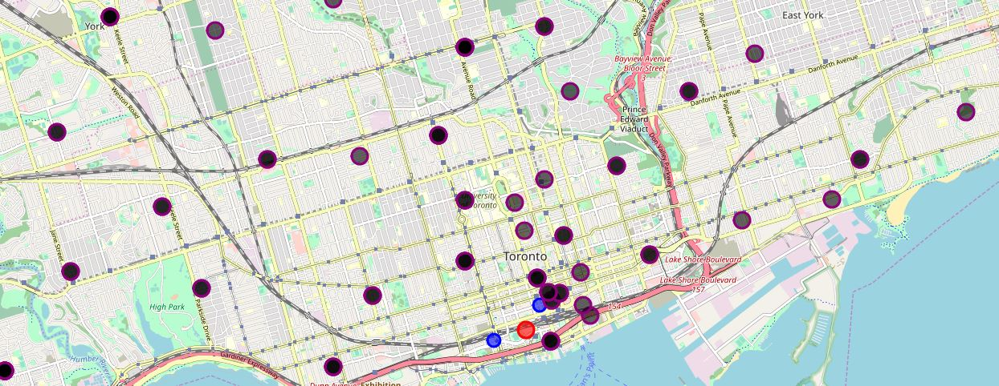
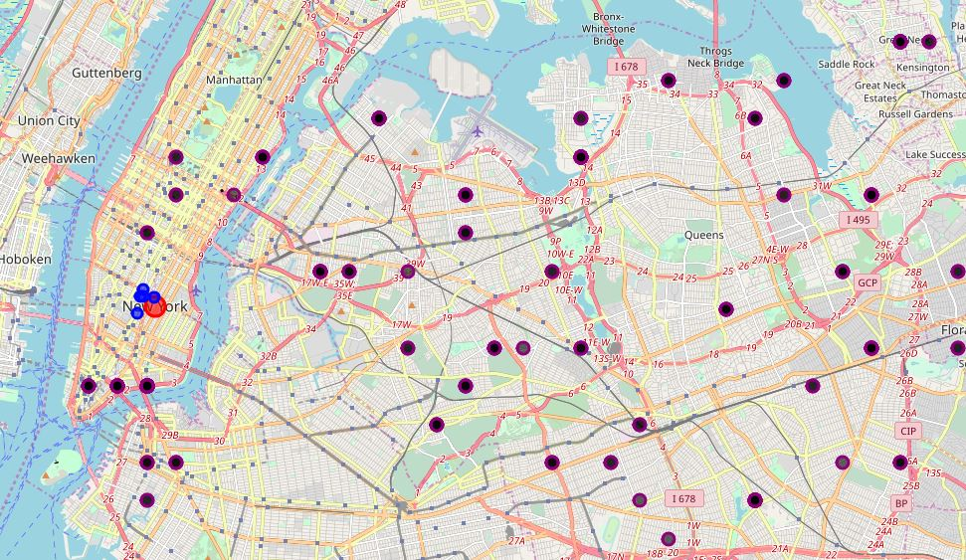
Data
Toronto
New York

Slide 4
New York Data
The competitors are the blue and red markers, the black markers are the neighborhoods.

Slide 5
Toronto Data
The competitors are the blue and red markers, the black markers are the neighborhoods.

Slide 6


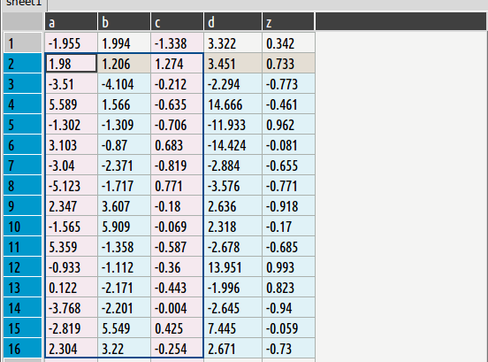
Methodology
Wikipedia to toronto CSV part 1 to dataframe to combined dataframe to map
Toronto CSV part 2 to Data Frame to the same combined dataframe to the same map
New York CSV to dataframe to map

Slide 7
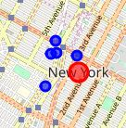
Results
Toronto has three competitors compared to New York’s six competitors

Slide 8
Discussion
Toronto is the better option because it has fewer competitors but still has a good amount of people

Slide 9
Conclusion
The Data clearly supports that the client should put their new headquarters in Toronto where there is more than enough people and fewer competitors.

